Slide 1
New Canton South High School
Academic Spaces Committee

Slide 2
Our Learners Prefer:
Doing hands-on activities
Variety
Being connected to technology
Working collaboratively
Solving real world problems
Producing a product to represent learning
Having choice/control
We need to create an environment for our learners to thrive!

Slide 3
The Future Demands That Our Students:
Can work collaboratively.
Can think flexibly.
Can utilize and integrate technology seamlessly in order to solve problems.
Can access the world.
Can produce and innovate.
We need to create spaces that allow students to build these skills!

Slide 4
Our Canton Local Graduate

Slide 5
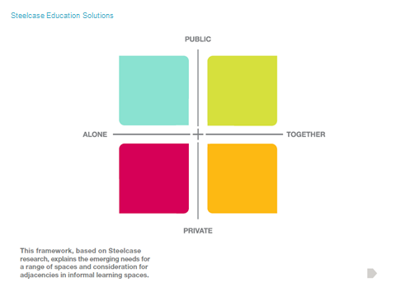
Steelcase Universit
Notes:
The following two grids are the conceptual pieces that can guide our space design. This grid takes the variety of ways individuals do their own work privately and together at different stages of learning and for different learning purposes.

Slide 6
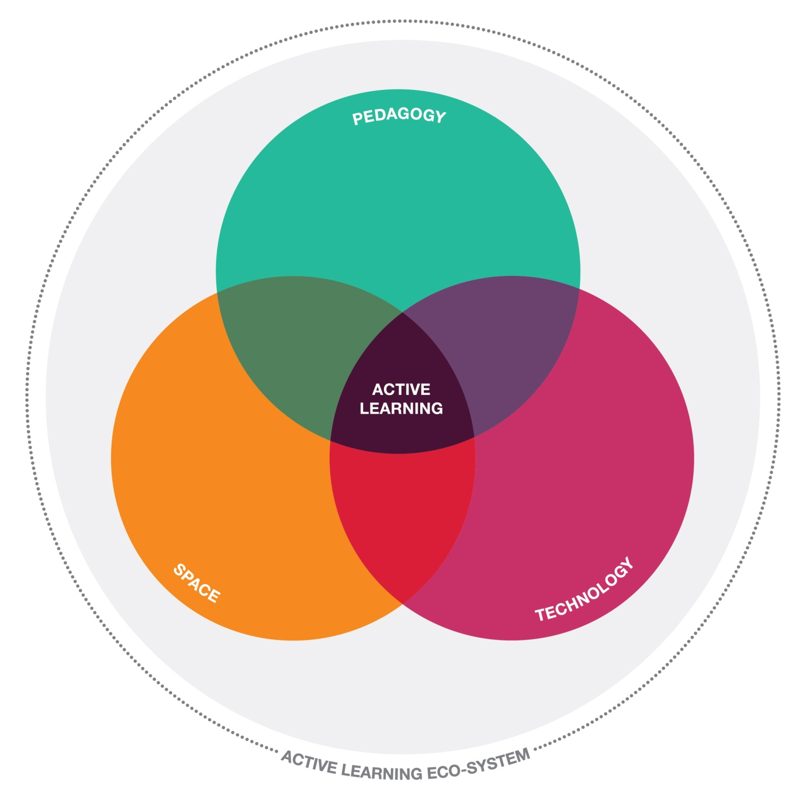
Notes:
This diagram illustrates the connections between pedagogy, space, and technology…in order to build an engaging and active learning environment for students and teachers.

Slide 7
Classroom
Notes:
This is a possible classroom design from Steelcase in Michigan. This is not necessarily the exact products and/or space we will have. This is one example of a classroom that can meet our learners’ preferences and prepare them for their future demands. It allows for flexibility, collaboration, integration of technology, and private spaces. (Refer to conceptual grid.)

Slide 8
Classroom
Notes:
This is a possible classroom design from Steelcase. It is not necessarily the exact products and/or space we will have. This another example of a classroom that can meet learners’ preferences and future demands. Students have the ability work together or privately, and they can integrate technology in a small and/or large group. (Refer to conceptual grid)

Slide 9
Fine Arts
Top Priorities:
Identify design priorities to meet the needs of our students NOW & in the FUTURE
Emphasize design for performance & exhibition spaces throughout the school where students’ products & performances are displayed for the school & community
Set up the infrastructure to support future equipment additions that are outside of our current budget

Slide 10
Fine Arts – Visual Art
Visual Art Key Points
Flexibility
Meaningful, collaborative workspaces
Readiness for 21st Century learning
Hands-on & Technology-based Experiences

Slide 11
Visual Arts

Slide 12
Visual Arts - Music
Music Key Points
High quality acoustics
Adequate space
Flexibility

Slide 13
Music

